Slide 1
Unit 2
What time do you
go to school?
Section B 3a-Self Check
七年级(下)

Slide 2
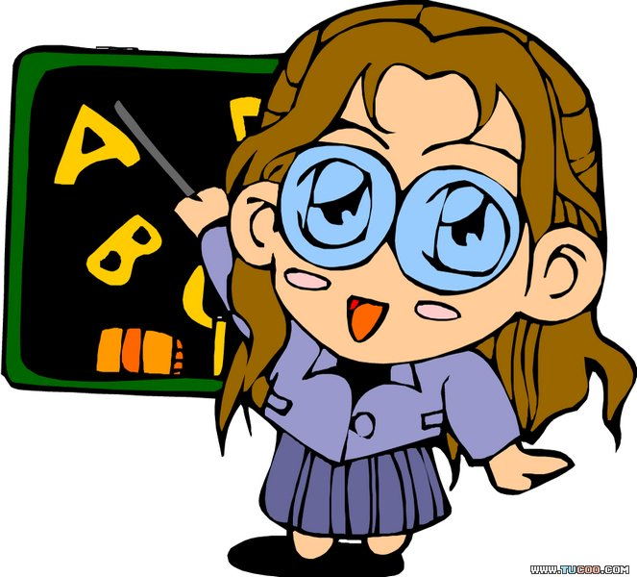
Objectives
To learn to write about daily routines

Slide 3
学唱下列歌谣。
Get up, get up.
I get up at six.
Go to school, go to school,
I go to school at seven.
Have lunch, have lunch,
I have lunch at twelve.
Go home, go home,
I go home at four.
Go to bed, go to bed,
I go to bed at night.
Lead-in

Slide 4
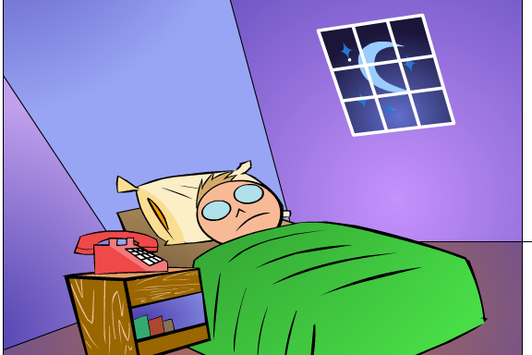
Just for fun!

Slide 5
Key words check.
time morning breakfast get up
go to bed homework clock
afternoon lunch run watch TV
evening dinner eat usually
o’clock thirty fifteen
take a shower go to school
go home

Slide 6
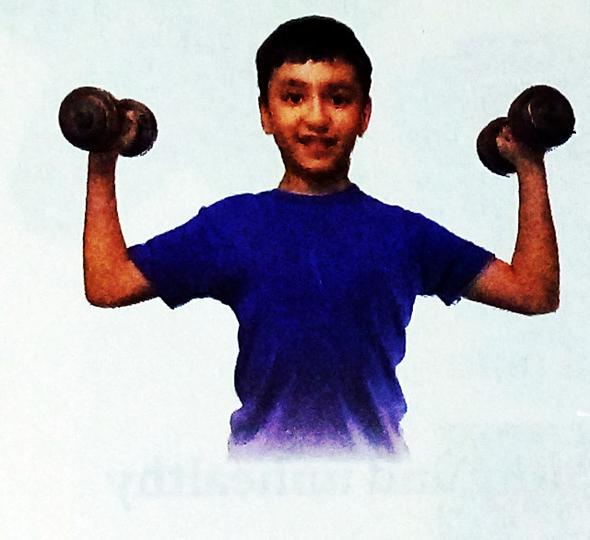
3a Number these sentences in order to make a story about a daily routine.
3
___ I usually exercise from six fifteen to seven.
___ I always get up early at six.
___ After that, I always brush my teeth and go to school
at eight.
___ Then I quickly have a shower and eat breakfast.
___ I have lunch at a quarter to twelve.
___ I get home from school at half past
four and do my homework.
___ I have a very healthy life.
___ I have dinner at seven thirty.
___ I go to bed at ten.
2
5
4
6
7
1
8
9

Slide 7
3b
Write about your own daily routine.
________________________________
_______________________________
_______________________________
_______________________________
_______________________________
_______________________________
________________________________

Slide 8
写作指导：
回想一下上个环节中自己一天的作息。
按时间的先后，逐条叙述。
注意运用正确的英语表达方式：
I+ usually/often+动词短语+at+时间。

Slide 9
One possible version:
I have a healthy life. I usually get up at seven. I exercise from a quarter past seven to half past seven. Then I have breakfast and brush my teeth. I go to school at eight o’clock. I have lunch at twelve o’clock. I get home from school at half past four and do my homework. I have dinner at six and then I watch TV. I go to bed at nine thirty.

Slide 10
My weekends
Think about your weekends’ activities then fill in the blanks.
 | Activities | Time
morning | get up
 | exercise
 | eat breakfast
noon | have lunch
afternoon | play sports
 | meet friends
evening | eat dinner
 | watch TV
 | go to bed

Slide 11
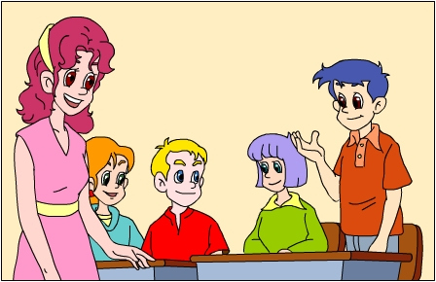
Tell your classmates about your life
on weekends.
I have a relaxing weekend. I usually get up at eight. Then I exercise for half an hour. I eat breakfast at nine. I brush my teeth at nine past twenty. I …

Slide 12
1.Match the verbs in column A with the words in column B. Then use the phrases to complete the sentences.
Self-Check
A B
taste
clean
have
get
take
brush
your teeth
my room
a walk
good
dressed
a good job

Slide 13
tastes good
1. Ice-cream usually _____________, so students like to eat it after school.
2. My grandparents are very healthy. They always ___________ after dinner.
3. You need to ________________ after eating to have good teeth.
4. He _______________. He works at a radio station.
5. Here are your clothes. Go and ____________ quickly!
6. I don’t have time to ______________ from Monday to Friday. So I clean it on weekends.
take a walk
brush your teeth
has a good job
get dressed
clean my room

Slide 14
2.Complete the conversations with the questions and answers. Use the words in brackets to help you.
What time does your mother usually get up
1. A:_______________________________________?
(your mother/usually/get up)
B:_____________________.
(5:45)
A:____________________________?
(why/get up/so early)
B:______________________________________.
(always/make breakfast for me)
At a quarter to six
Why does she get up so early
Because she always makes breakfast for me

Slide 15
What time do you usually get to school
2.A:_________________________________?
(you/usually/get to school)
B:_____________________________.
(7:30)
A:________________________________
____________________?
(your class teacher/usually/get to school)
B: I don’t know. But he/she is never late for the first class in the morning.
At half past seven
When does your class teacher
usually get to school

Slide 16
Exercise
一、根据本单元所学词汇, 补全单词
sh_w_r _’cl_ck _v_ning
ar_ _nd  h_m_w_rk d_nn_ _
br_ _kf_ _t l_ _ch f_ft_ _n
u_u_lly _lw_ys s_rv_y

Slide 17
Check the answers!
sh_w_r _’cl_ck _v_ning
ar_ _nd  h_m_w_rk d_nn_ _
br_ _kf_ _t l_ _ch f_ft_ _n
u_u_lly _lw_ys s_rv_y
o
e
o
o
e
e
ou
o
e
o
i
e r
e a
a s
un
i
e e
s
a
a
a
u
e

Slide 18
二、翻译下列词组
起床 ____________
2. 吃早饭 ____________
3. 在早晨 _____________
4. 穿上 __________
5. 去上班 ____________
6. 听音乐 ____________
7. take a shower __________
8. go to school ____________
9. sleep a little longer _________________
10. after breakfast ____________
11. at night ____________
get up
eat breakfast
in the morning
put on
go to work
listen to music
洗澡
上学
稍微多睡一会儿
早饭之后
晚上

Slide 19
三、根据句子及汉语意思, 完成句子。
My brother usually ________
(开始) to run at six.
2. They eat some __________ (健康的)
food for dinner.
3. My mother works three ________
(小时) every night.
4. I think the comedies are ________
(令人兴奋) movies.
starts
healthy
hours
exciting

Slide 20
四、根据提示完成句子。
1. It’s nine o’clock. (提问)
________ the ________?
2. He can do Chinese kung fu. (一般疑问句)
_______ he _______ Chinese kung fu?
3. Tim usually goes to bed at 10:00. (提问)
_______ _______ does Tim usually _______
to bed?
4. I do homework at seven. (否定句)
I _______ ________ homework at seven.
What’s
time
Can
do
What
time
go
don’t
do

Slide 21
五、根据实际情况回答。
What time do you usually get home from school? ______________________________
2. What time does your father usually go to work? _____________________________
3. When does your grandparents usually have lunch? _________________________ __________________
I usually get home at half past five.
He usually goes to work at eight.
They usually have lunch at a quarter to twelve.

Slide 22
4. What time does your mom get home in the afternoon?
_______________________________
5. When does your father usually go to bed?
_______________________________
___________
She usually gets home at five o’clock.
He usually goes to bed at a quarter
to eleven.

Slide 23
六、补全对话。
A: What time does your son usually get up?
B: He usually _____ up at half past six. Then he always exercises ____ 6:30 __ 7:00.
A: When does he usually have breakfast?
B: He _____ a shower at 7:10 and he ____ breakfast at 7:30. Then he goes to school at 8:00.
gets
from to
takes
has

Slide 24
A: Great! I think he has a healthy ____.
B: Yes. And he usually ____ home ____ school at five. He ____ his homework first. Then he plays sports ___ half an hour.
A: When does he go to bed?
B: At half past nine.
life
gets from
does
for

Slide 25
七、单项选择
A
1. — _______ is it?
— It’s nine o’clock.
A. What time B. What
C. How D. Where
2. I usually _______ at nine-thirty at
night.
A. get to school B. get up
C. go to bed D. go home
C

Slide 26
3. My sister _______ home at 5:00
every day.
A. gets B. gets to C. get D. get to
4. Ji Min usually gets up _______.
A. at six thirty B. at thirty six
C. on six thirty D. on thirty six
5. Rick often does ______ homework
at 6:00.
A. he B. his C. my D. your
A
A
B

Slide 27
C
6. In our school, class _____ at 7:30.
A. is B. start C. starts D. does
7. Please write and tell us _____ your
morning.
A. for B. about C. of D. from
8. — ______ do people have dinner?
— At home.
A. What B. When
C. Where D. B and C
B
C

Slide 28
八、翻译下列句子：
1. 你通常什么时候睡觉？
2. 我通常在学校吃午餐。
3. 放学后我通常打篮球。
When do you usually go to bed?
I usually have lunch at school.
I usually play basketball after school.

Slide 29
4. 我的小弟弟通常在8点起床。
5. 通常我们下午上两节课。
6. 你认为他的工作是什么?
My little brother usually
gets up at 8 o’clock.
We usually have two classes
in the afternoon.
Can you think what his job is?

Slide 30
7. 她通常几点洗澡？
8. 他在晚上9点洗澡。
9. 我在早上喜欢多睡一会儿觉。
What time does she take a shower?
He takes a shower at 9 o’clock
in the evening.
I like to sleep a little longer
in the morning.

Slide 31
Project
Make a survey to find out what
your classmates do on weekends.
Weekend survey
 | S1 | S2
What time do you get up?
What time do you go shopping?
…

Slide 32
Homework
根据表格提示，以My day为题，
写一写自己周六的活动安排。
跑步 | 6:30 a.m. | 看电视 | 1:00 p.m.
吃早饭 | 7:00 a.m. | 做作业 | 3:00 p.m.
购物 | 9:00 a.m. | 做家务 | 5:00 p.m.
吃午饭 | 12:00 p.m. | 吃晚饭 | 6:00 p.m.

Slide 33
Thank You!

